Slide 1
Programming 2 Interactive Notebook (“Notes”)
Mr. M

Slide 2
Iterative Design Process

Slide 3
What is iteration
Trying to study, or improve something, then making something new, and making something better

Slide 4
Analyze the problem
CSPG.Y2.1.5 Decompose problems of level-appropriate complexity
CSPG.Y2.1.1 Leverage problem-solving strategies to solve problems of level-appropriate complexity
The 3 strategies we will use is the iterative design process, suto code, and flowcharts.

Slide 5
Determine the best solution/PsuedoCode
CSPG.Y2.1.2 Analyze and utilize multiple representations of problem-solving logic used to solve problems of appropriate complexity

Slide 6
Design the Solution/Prototype/Initial Code

Slide 7
TEST

Slide 8
Iterate or Present

Slide 9
How does this apply to Software Development
CSPG.Y2.10.5 Explain advantages and disadvantages of various software life cycle processes (e.g., Agile, spiral, waterfall)

Slide 10
Agile
Agile iterations (Sometimes called a Sprint) are usually between two and four weeks long, with a final completion date. The workflow of an Agile iteration will typically consist of five steps:
Plan requirements:
Develop product
Test software
Deliver iteration
Incorporate feedback
Iterate or Present (or Commit)

Slide 11
Agile - Sprint
A sprint is designed to focus on ONLY ONE FEATURE
There will be multiple Sprints to complete a project
In your more simple projects, you have have multiple sprints in a class period
This helps you stay on task to complete individual pieces of the code and minimize errors.

Slide 12
Waterfall
Move from one step to the next once the whole thing is finished
Less focus on iterative testing while building
More risk of failure
Greater speed IF… IF… No errors

Slide 13
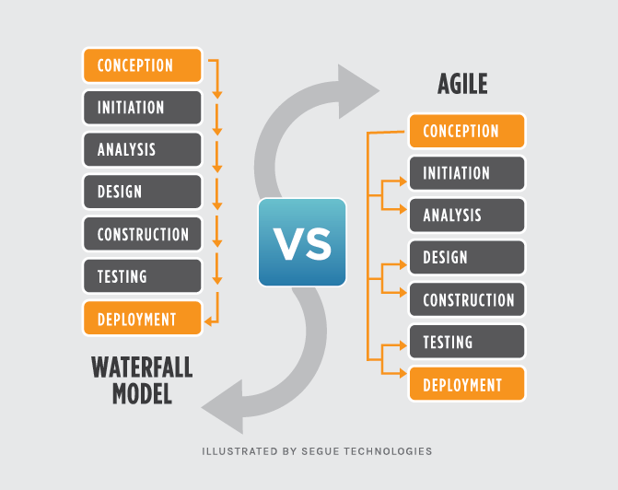
Waterfall vs agile

Slide 14
Other Software Development Methods
SOOOOO Many !

Slide 15
Programming Review

Slide 16
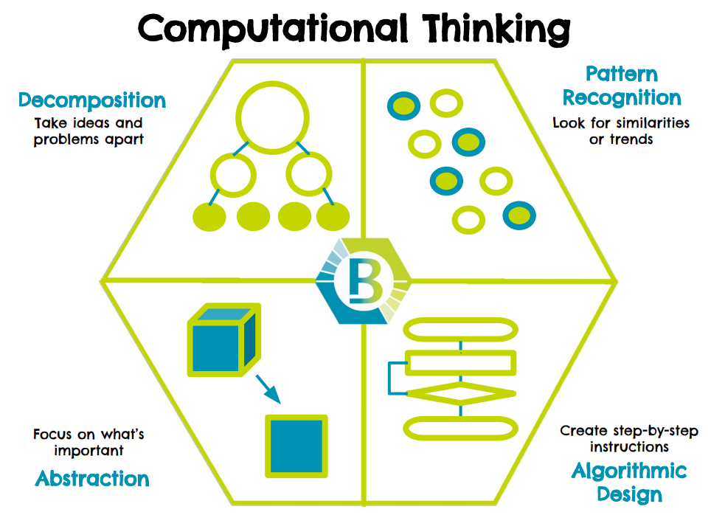
Computational Thinking

Slide 17
Programs vs Algorithms

Slide 18
What is a program?
A type of file that stores code, or a test file

Slide 19
What is an algorithm?
A step-by-step instruction to do something.

Slide 20
Language

Slide 21
What is a language
A language is a structured system of communication
Rules of a language are called syntax

Slide 22
Types of language
Natural Language
People Speak these
Change easily
Yeet
Lit
“Gotchu Fam”
All that matters is understanding
Artificial Language
Also Called Formal Languages
Created for Specific Purposes
Programming Languages are an example
Have clearly defined rules

Slide 23
What is a Programming Language
A type of way you communicate to things

Slide 24
High Vs Low
High abstractions means more simpler, low abstraction is more complexed

Slide 25
High Vs Low
PseudoCode - Highest
Interpreted Language - Higher
Compiled Languages - High
Machine Languages - Low
Binary - Even lower
Interpret at runtime

Slide 26
Abstraction
Abstraction is taking low-level details and simplifying them into a higher-level.
Taking the Details and ignoring them so you can focus on the "Big Picture"
Forest instead of trees

Slide 27
PseudoCode and Abstraction

Slide 28
What is PseudoCode?

Slide 29
1st PsuedoCode

Slide 30
What is Abstraction in a program?

Slide 31
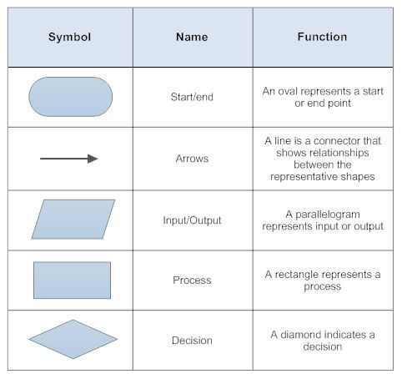
1st Flowchart

Slide 32
Troubleshooting and Getting help
Pseudo Code - Must be written in notebook or typed as docstring on code - May also be flowchart
Talk through code - to neighbor, plushy, or OUTLOUD to self
Google the Documentation
Ask Neighbor
Ask Me

Slide 33
Programming Languages

Slide 34
C/C++
Lower Language (More Control - Low Abstraction)
FAST!!!! - Zoom zoom— much faster than python
C++ Added OOP
We use for Arduino
Embedded systems like IOT and Robotics
Compiled

Slide 35
Python
High Level Language
Slower
Interpreted
Data Science, Some Web, Fastest Growing
We use on PCs, Anvil, Repl.it and ESPs

Slide 36
Other that you might use
Java - AP CSA, lots of large companies, android apps - Compiled
Html, css, PHP - Web Sites -Interpreted
Javascript - Modern Web Design -Interpreted
SQL - Databases -Interpreted
Swift - only Mac - Compiled

Slide 37
Programming

Slide 38
Programming Tools

Slide 39
Text Editor

Slide 40
Code Completion/Suggestion

Slide 41
Linter
A program that works inside of a program used to label certain codes lines

Slide 42
Compiler/Interpreter

Slide 43
Debugger

Slide 44
Version Control
We use GitHub.com
Create an account now
Use School Email Address
Must have School Approriate Name

Slide 45
IDE

Slide 46
MicroControllers

Slide 47
Setup

Slide 48
Blink

Slide 49
Sensor

Slide 50
Button

Slide 51
Blink on Button

Slide 52
VSCode

Slide 53
Hello World

Slide 54
Variables

Slide 55
Comparisons

Slide 56
Flow Control

Slide 57
Flow Control - while

Slide 58
Flow Control - For

Slide 59
Flow Control - If

Slide 60
Flow Control - If elif else

Slide 61
Github -
version control

Slide 62
Portfolio Site

Slide 63
Topics that need covered

Slide 64
Pretty Code

Slide 65
Base Numbers

Slide 66
Conventions WHY?
https://realpython.com/python-pep8/#why-we-need-pep-8

